Slide 1
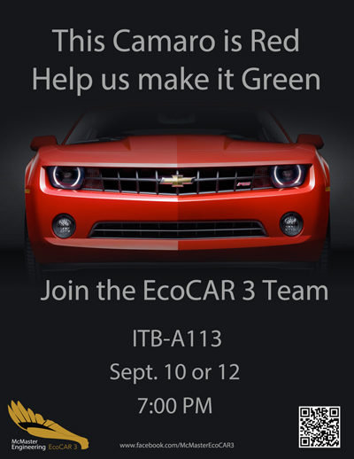

Slide 2
EcoCAR 3 Information Session
September 10th and 12th, 2014

Slide 3
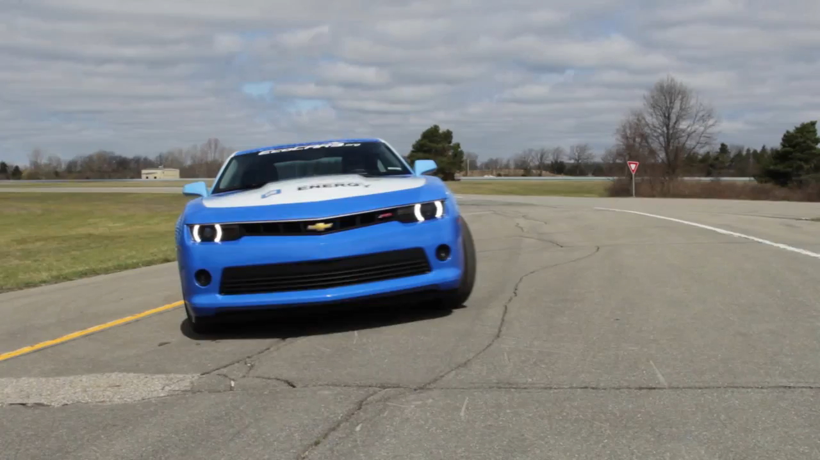

Slide 4
What is happening with Formula Hybrid?
Competing in both EcoCAR 3 and Formula Hybrid in 2014/2015
Transition to EcoCAR 3 from 2015 to 2018 (4 years total)
Use Formula Hybrid build this year to teach skills and concepts
Knowledge transfer is a HUGE priority

Slide 5
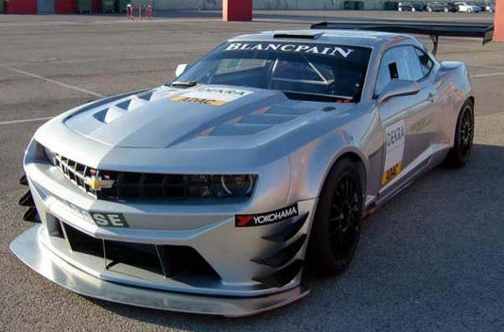
What are we going to build?

Slide 6

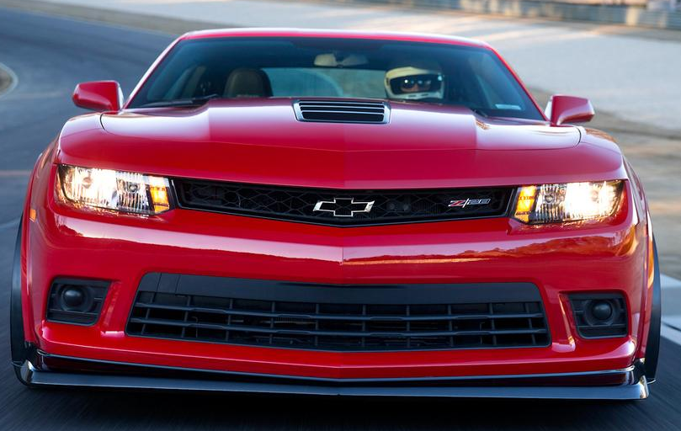
What are we going to build?

Slide 7
What are we going to build?
Official Rules to be released on Sept. 16, 2014
High Performance Hybrid
  Bordering on Track Car - LMP
  700-900 hp combined
  900-1100 Nm Torque (Lamborghini Gallardo – 510 Nm)
  Full Active Aero
  Carbon Fiber Body
  Data Acquisition System
  Pushrod Suspension
  Human Machine Interface

Slide 8
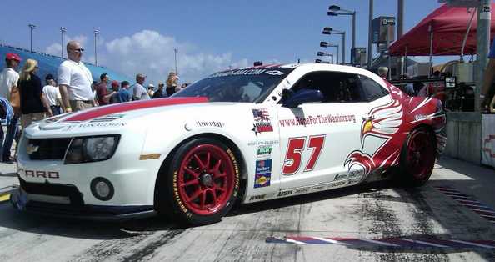
Who are we going to work with?
Katech Performance

Slide 9
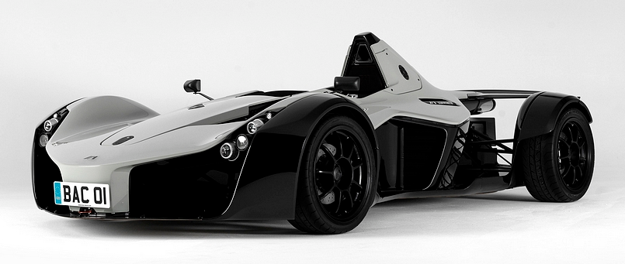
Who are we going to work with?
Apex Composites

Slide 10
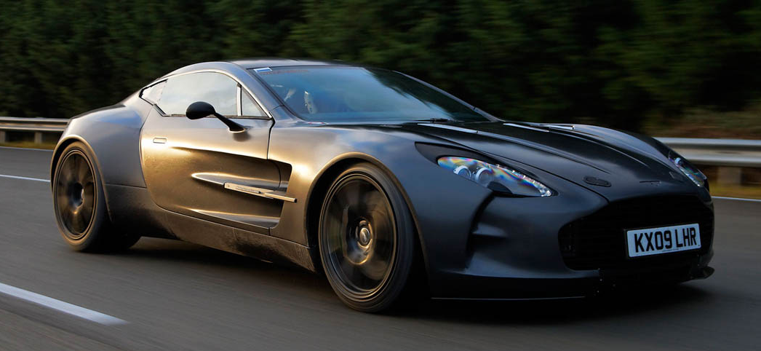
Who are we going to work with?
Multimatic

Slide 11




Who are we going to work with?

Slide 12


Slide 13
Course Credit
  MECH ENG 4M06 - Capstone
  ELEC ENG 4OI6 - Capstone
  Other smaller undergraduate design projects
  TRON 4TB6, SOFTWARE 4GO6, MECH ENG 3EO5
  Credit for extracurricular work
  Contact the team immediately if interested
      Email Will, longw@mcmaster.ca

Slide 14
Potential Projects
HMI center console
  Focused on ease of access of information and usability
HMI driver dash and steering wheel interface
Smartphone application interface to the car
  Driving range, SOC, alarm, lock/unlock, remote start, special attention to security
Smart charging design-V2G
  Power grid control of vehicle individual vehicle charging load on a mass scale
Detailed vehicle LV and HV component model
  Include power draw thermal generation and demand on thermal cooling system. To eventually be added to current powertrain models to give a more accurate picture of vehicle loads and as an extension fuel economy
Embedded Control for Specific tasks
  Thermal Management, Controlling Vehicle Body Accessories, Special attention to power draw and power moding capabilities.
Solar Roof
  Model, design embedded control, optimize cost vs weight vs performance.
Digital mirror and backup camera system with blind spot detection and parktronics.
Radar assisted cruise control
Lane Departure and/or Accident Detection

Slide 15
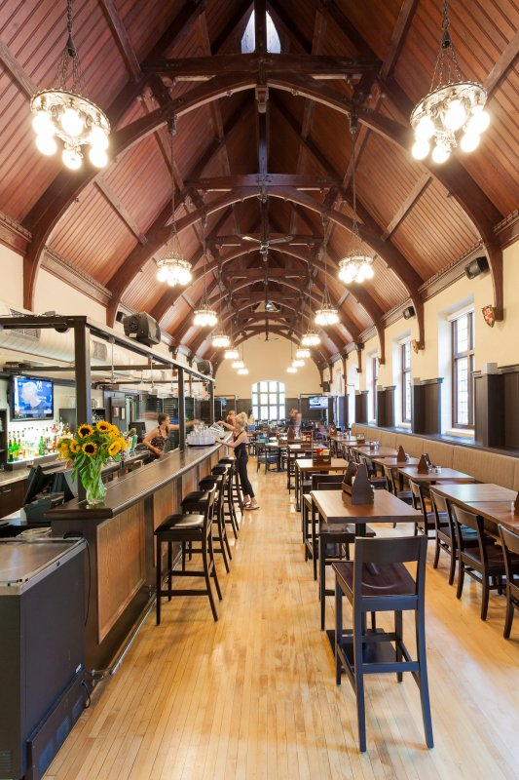
Phoenix Nights
  Once a week “Team Meeting”
  Entire team social event
  Food specials
  Drink specials (19+)
  Build an EcoCAR 3 “Family”

Slide 16
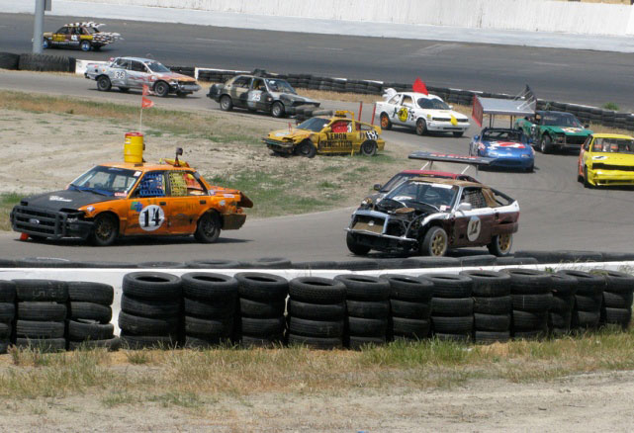

24 Hours of LeMONS

Slide 17
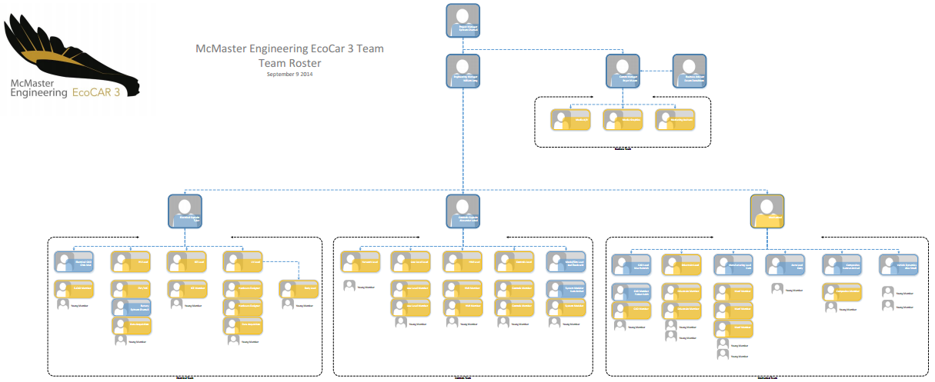
Communications
Electrical
Software & Controls
Mechanical

Slide 18
Application Process
Open Ended Application - “Learning Portfolio”
  No form or instructions
  Highlight individual projects:
    Arduino, Raspberry Pi, Beagle Bone
    Homebuilt Go-Kart / Soapbox Derby
    Software/Apps
    Side projects of any kind
  List interests and hobbies
  Tell us what is special about you, and what you hope to bring to the team
More details to be released in the coming weeks – but start thinking now

Slide 19
Application Review Process
Multiple interviews
Review of your Learning Portfolio
Investigation of prior knowledge
Multiple Learning Sessions
  Hands-on teaching: Carbon, PCB Design, etc.
  Teaching tutorials: Hybrid Architectures, Controls, etc.
  Testing: Rules, Tools
Everyone in any program, any age will be given equal opportunity

Slide 20
Questions? Comments?

