Slide 1
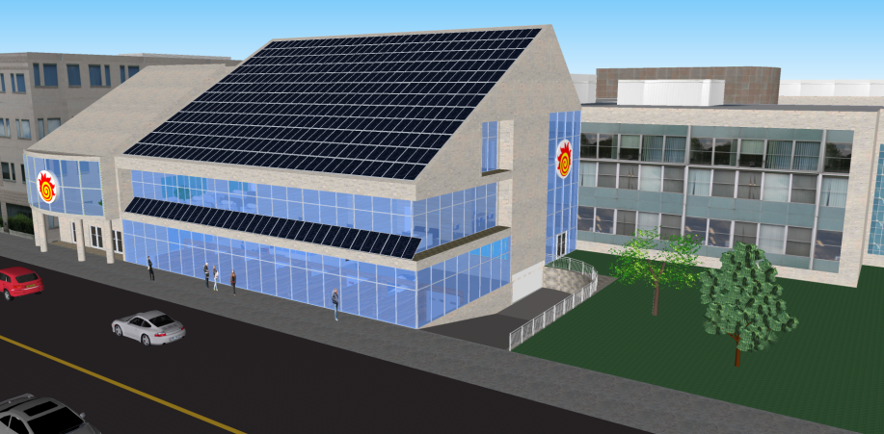
ExCEL: A Unique Approach to Providing Experiential Learning Opportunities
Engineering Centre for Experiential Learning

Slide 2
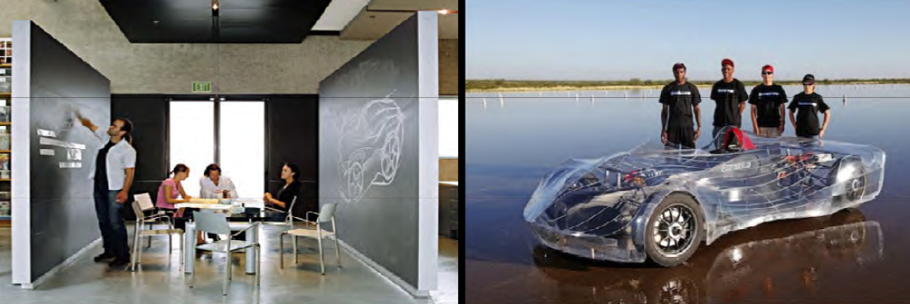
Story of how to use current experiential learning opportunities to develop future experiential learning opportunities

Slide 3
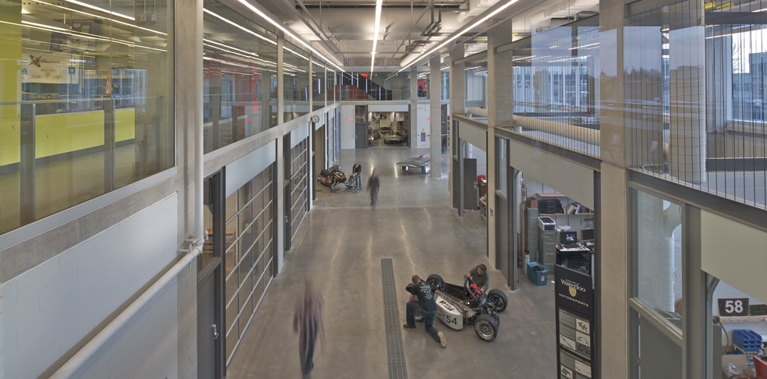
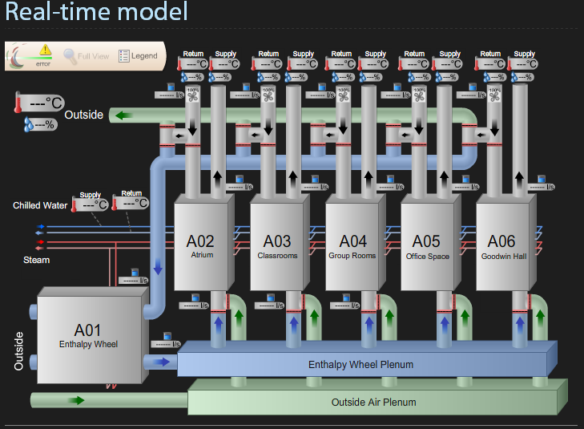
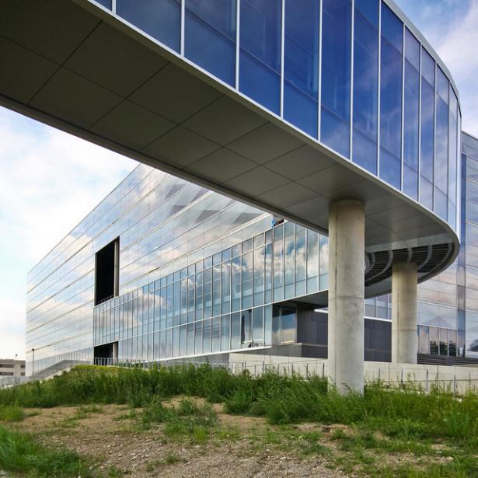
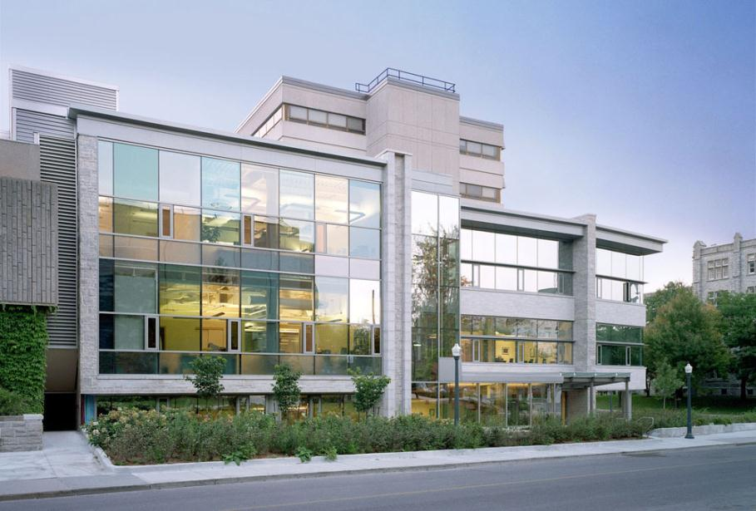
Background

Slide 4
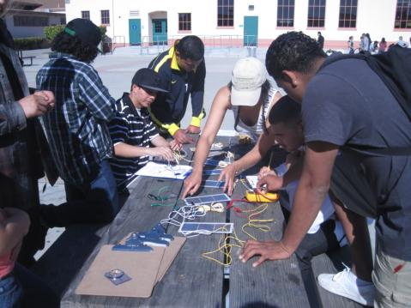
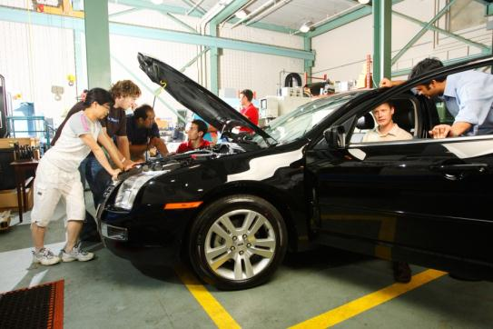
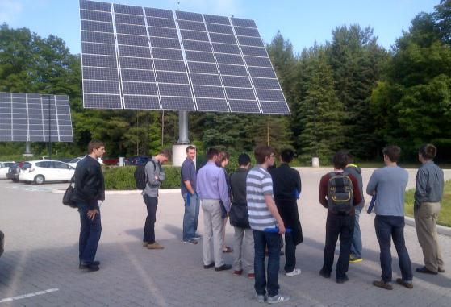
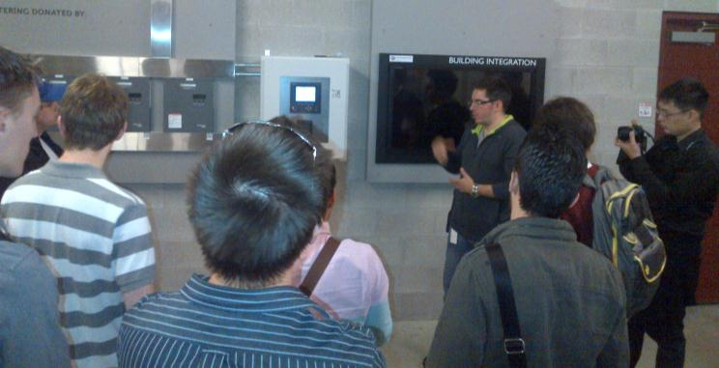
ExCEL’s Initial Goals
Experiential Learning
Living Lab of Sustainability

Slide 5
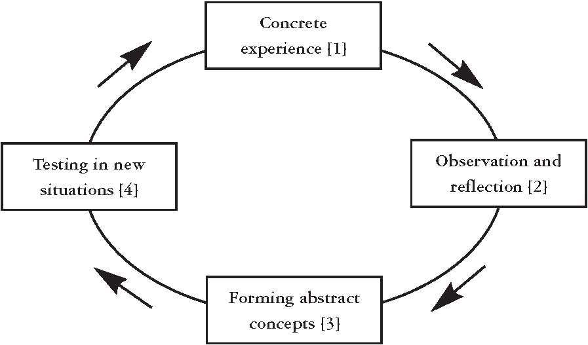
What is Experiential Learning?
The Experiential Learning Model is cyclical
Evidence based benefits:
– Complex processing
– Higher Order Thinking Skills
– Enjoy learning
– Cope with change
– And more!

Slide 6
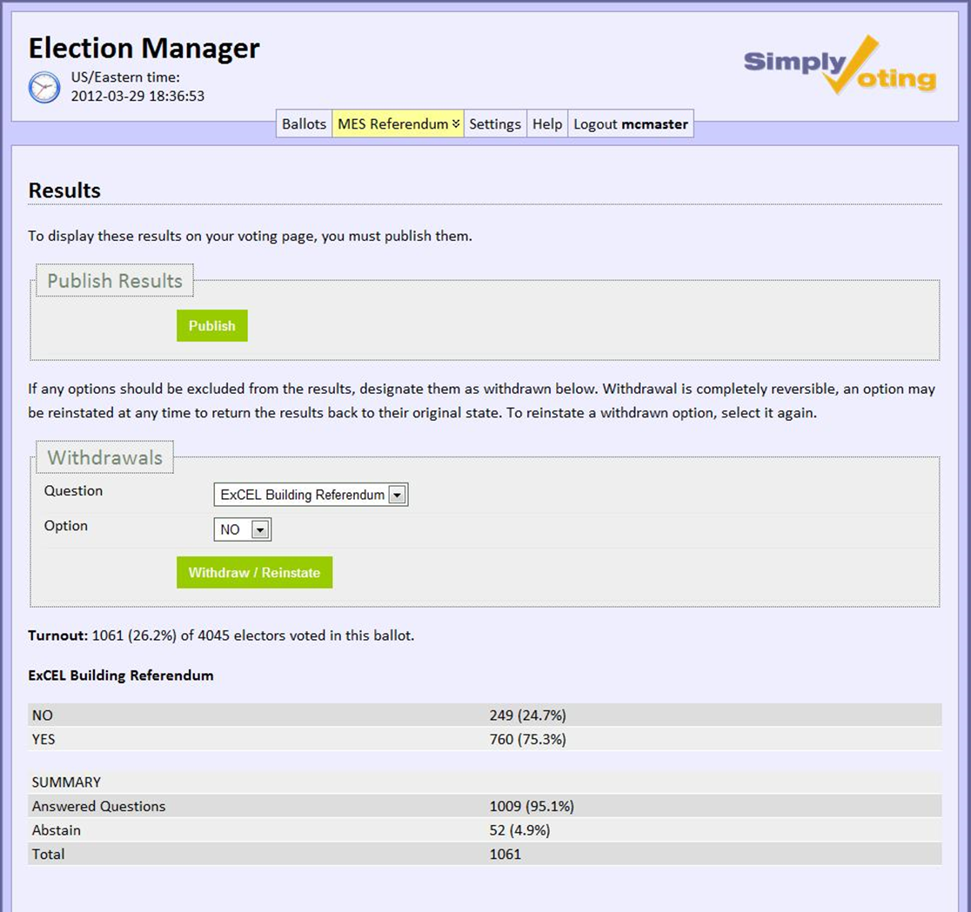
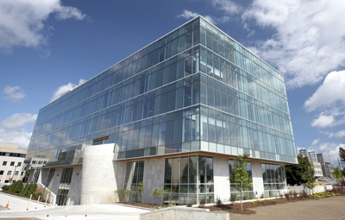

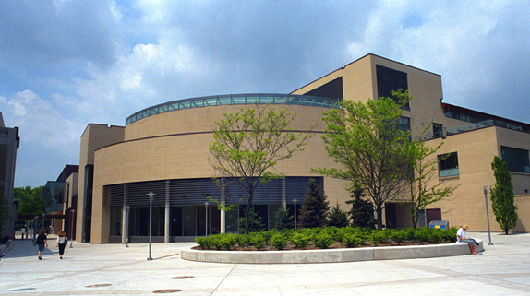
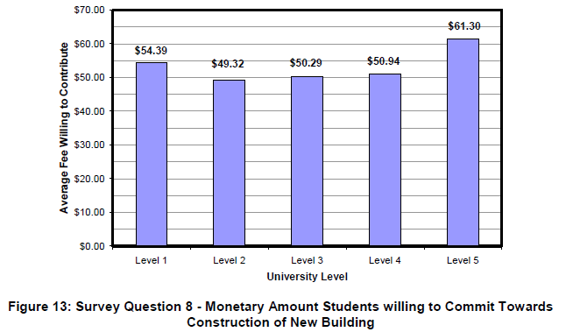
Funding
No Government funding available in time frame
No Government funding available in time frame
Donations Driven

Slide 7

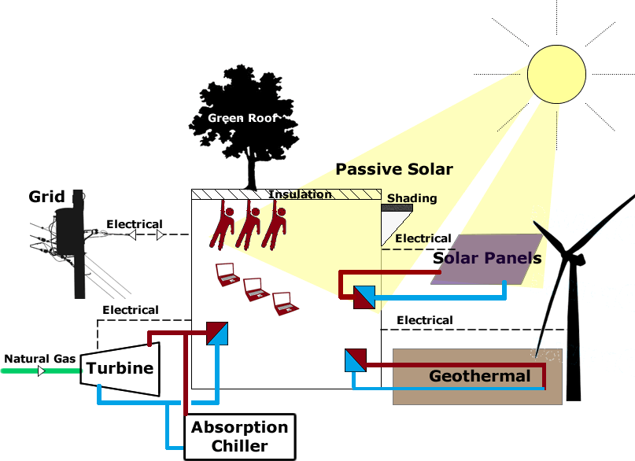
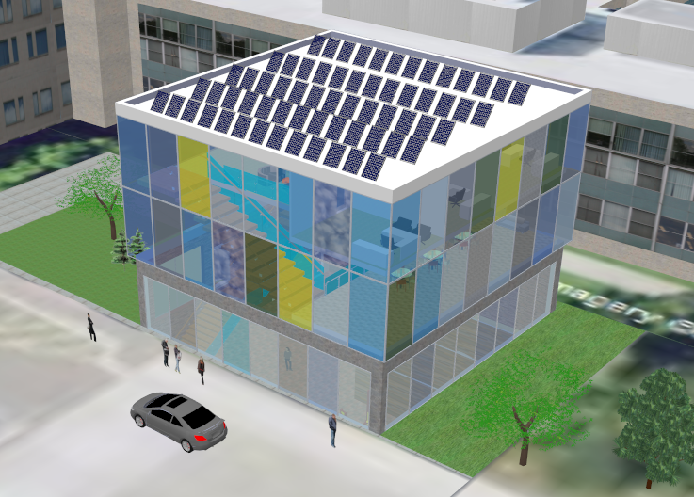
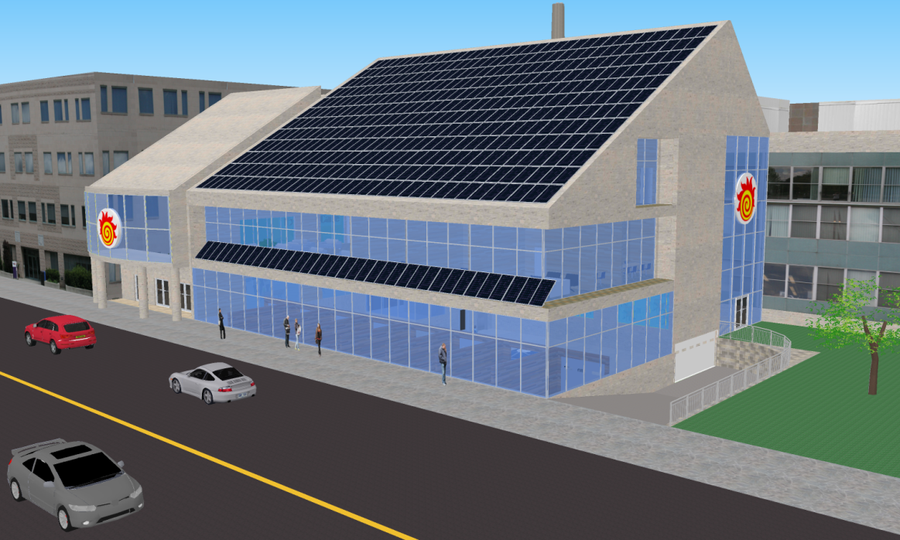
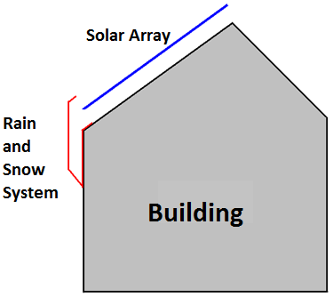
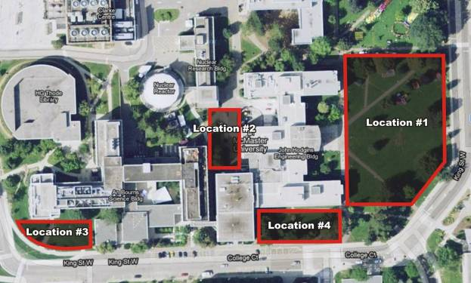
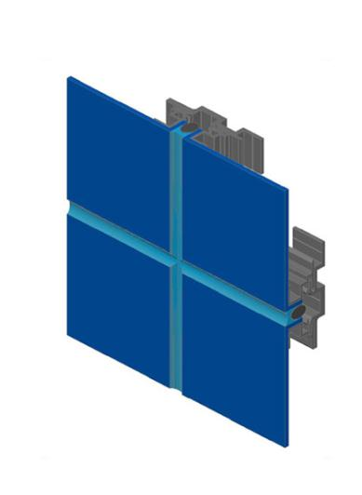
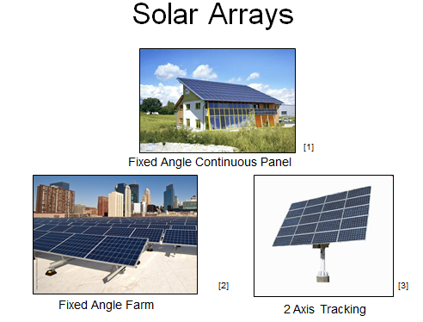
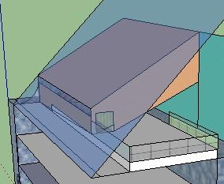
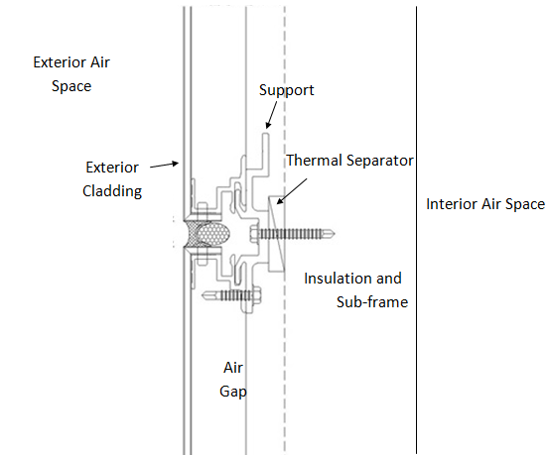
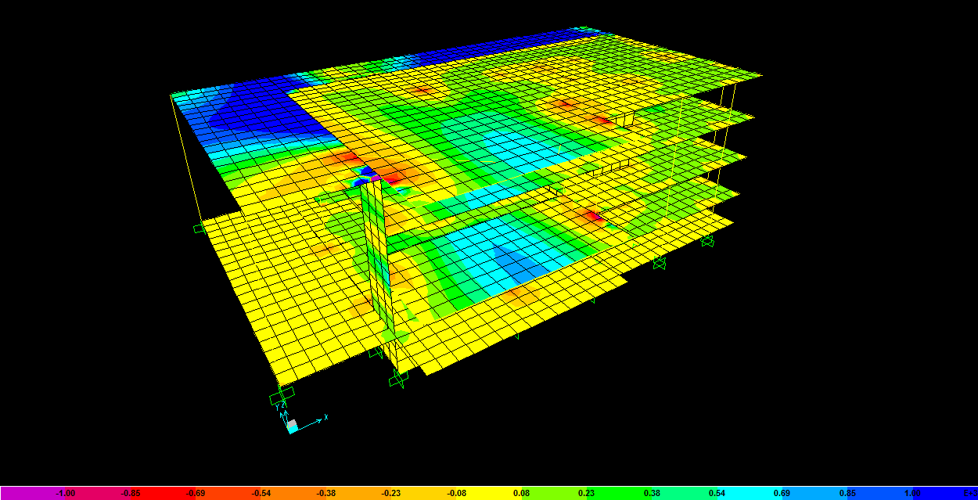
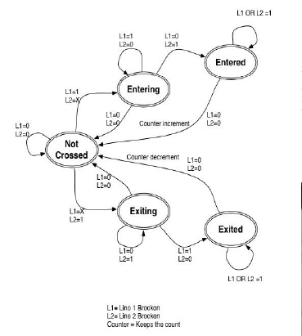
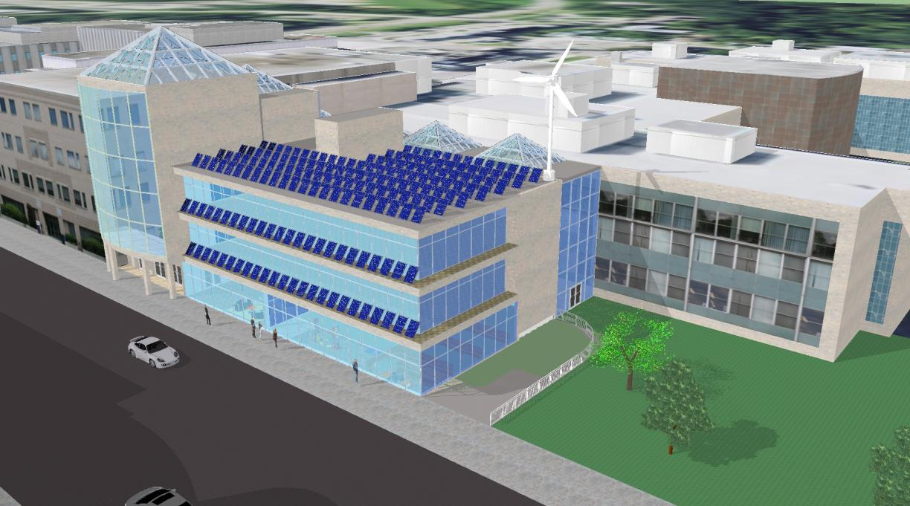
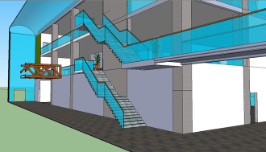
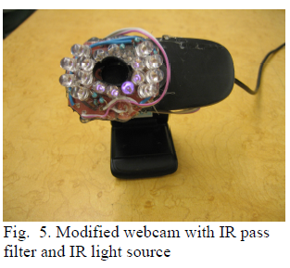
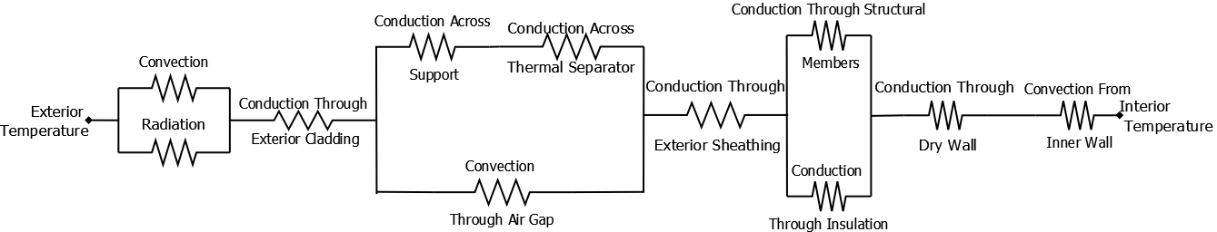
Design
Open ended design
Multi-disciplinary collaboration
Project-based learning
Professional development
Sustainability
Capstone Design Projects
  Teams acting as consultants, with Faculty as client
Industry-academic collaboration

Slide 8
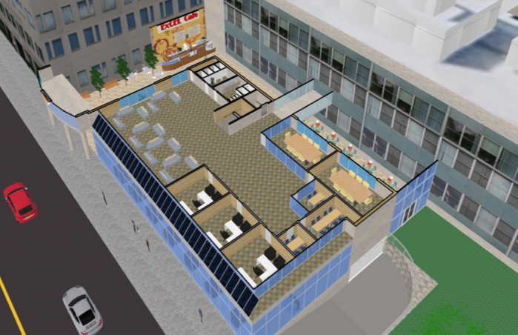
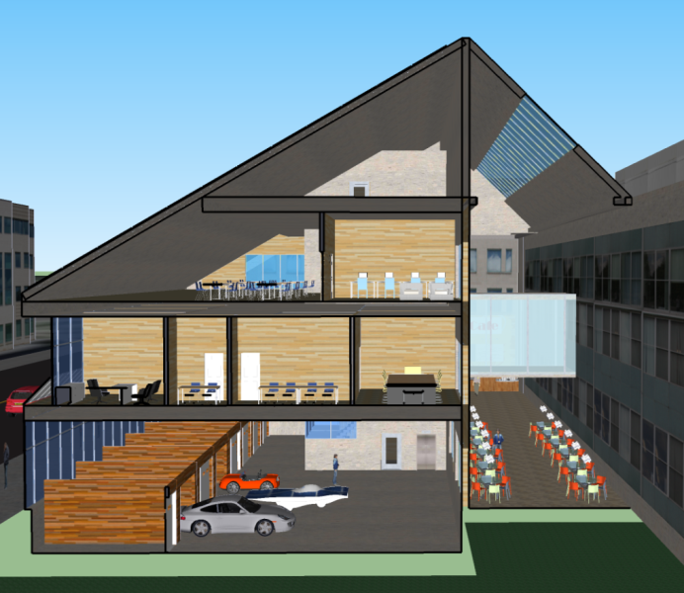
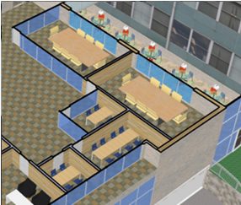
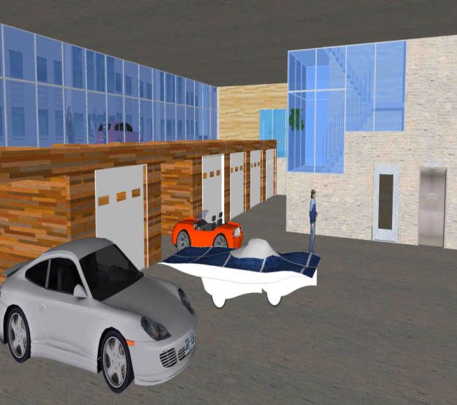
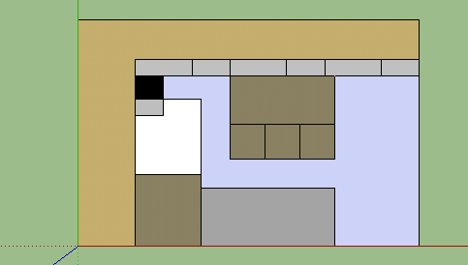
Design
ExCEL User Group Committee
Professional development

Slide 9
Student Projects - Total of 65 students
Mechanical Engineering 4M06
  Energy Systems Design and Analysis of the Engineering Student Centre (April 2011)
  Electrical and Thermal Energy Audit and Feasibility Study of a new net zero ExCEL Engineering Student Centre (April 2011)
  Solar Array Design for the Proposed ExCEL Building (April 2012)
Engineering Management 5B03
  Student Community Needs Assessment and Green Technology Research (December 2010)
  ExCEL Building Energy System Analysis and Recommendation (December 2011)
  Space Allocation Project for the ExCEL Building, McMaster University (December 2011)
  ExCEL Building Solutions: Occupancy Tracking and Security Access Systems (December 2012)
  Sobotec Cladding on ExCEL (December 2012)

Slide 10
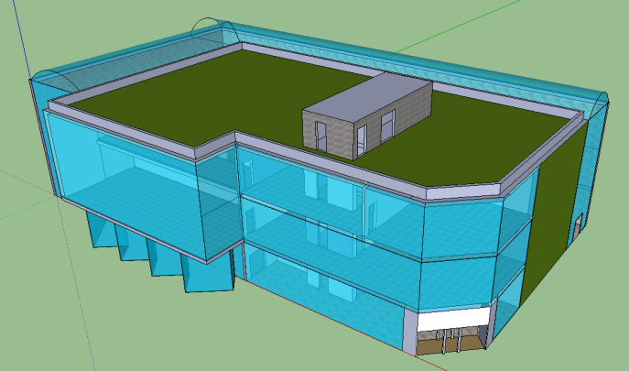
Student Projects - Total of 65 students
Civil Engineering 4R04
  The Engineering Student Centre (April 2011)
Materials 4I03
  Cellulose Vs. Fiberglass Insulation
  Concrete Vs. Steel Beam
  Silica Aerogel Vs. Double Pane Windows
  Linoleum Vs. Vinyl Flooring
Mechatronics 4TB6
  Using Biometrics for Secure Access (April 2013)
  Using Wireless Communications for Secure Access (April 2013)
Electrical and Computer Engineering 4OI6
  Secure Access Doors (April 2013)
Mechanical Engineering 3E05
  Flexibility of Rooms in ExCEL(April 2013)

Slide 11
ECE Capstone Ideas

Slide 12
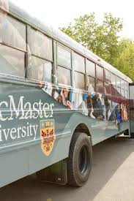
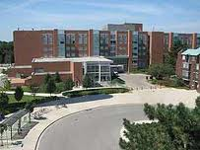
Security Services - Image Processing

Slide 13
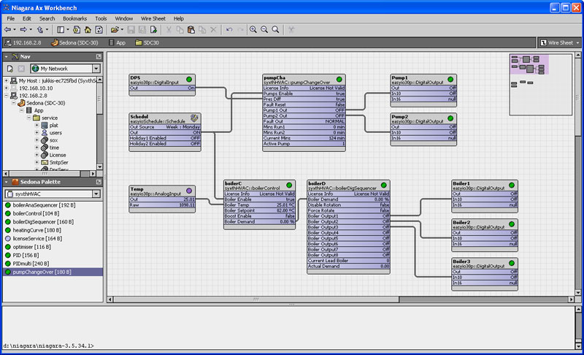
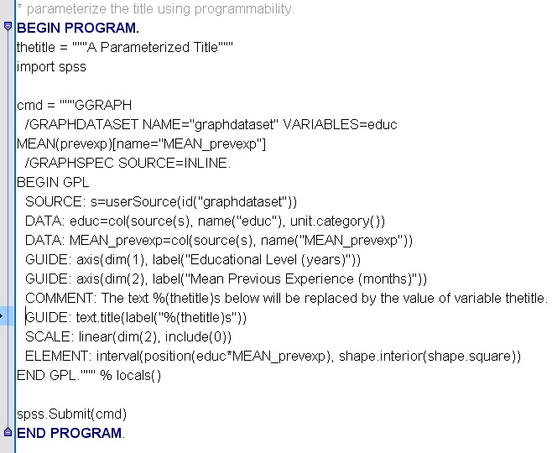
Facility Services – Block Programming

Slide 14
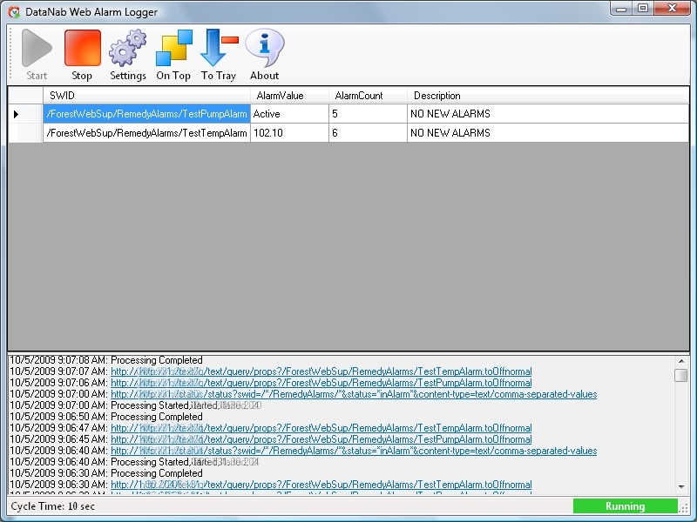
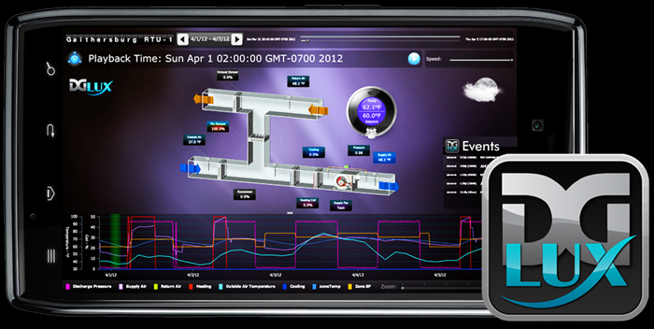
Facility Services – Building Alarm Notification

Slide 15
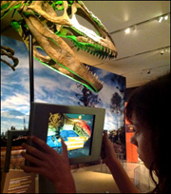

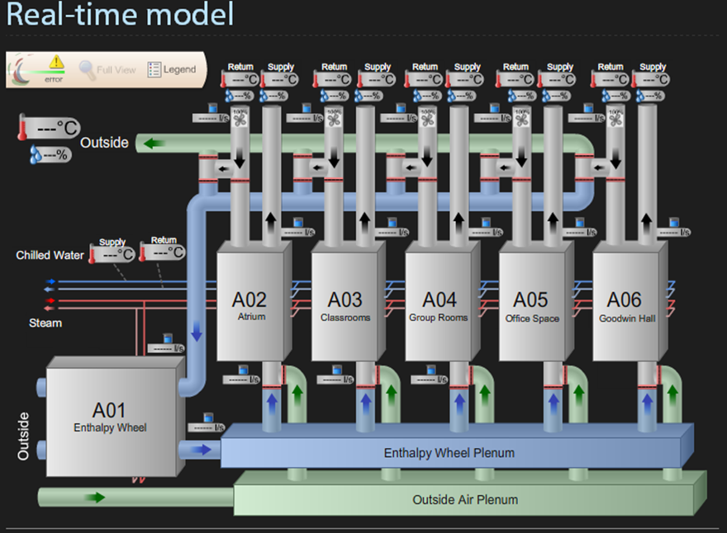
Augmented Reality in ExCEL

Slide 16
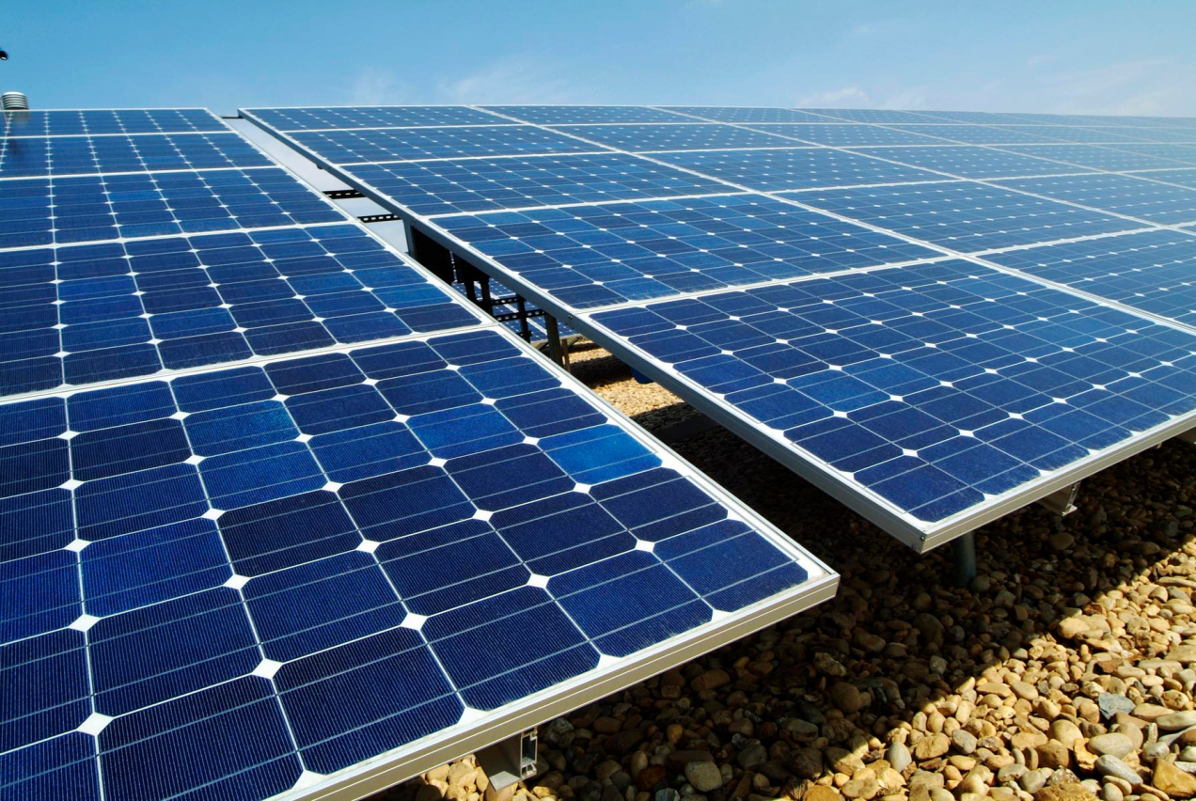
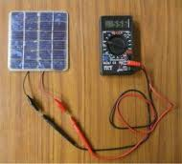
PV Panel Entire Performance Monitoring

Slide 17
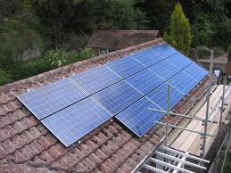
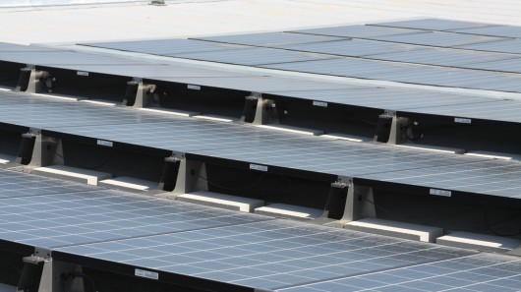
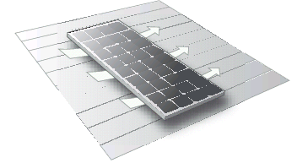

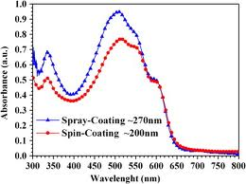
PV Panel Retrofits to Increase Performance

Slide 18



Building Sensor Circuitry and Commissioning

Slide 19



Direct Current Microgrid Components for Maximizing Renewable Generation

Slide 20
Always open to other ideas!
For those that would like to engage on this Initiative Contact:
www.eng.mcmaster.ca/excel
Kelton Friedrich
JHE-123
905-525-9140 Ext 21524
friedrke@mcmaster.ca

Slide 21


Slide 22


Slide 23


Slide 24


Slide 25


Slide 26


