Slide 1
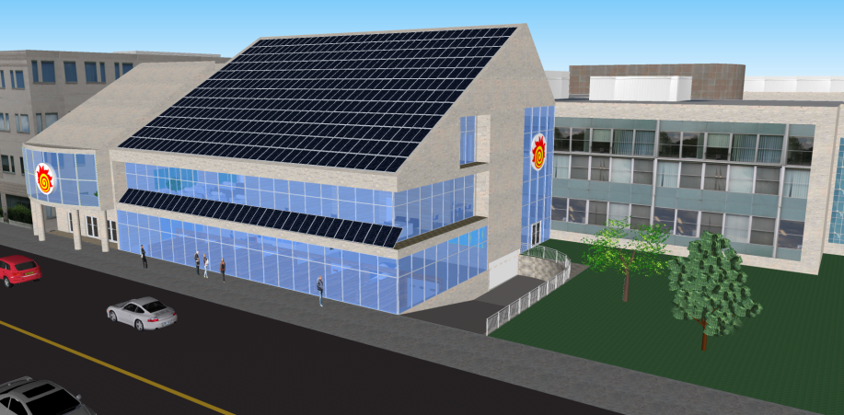
The Hatch Centre: A Unique Approach to Providing Experiential Learning Opportunities
Gerald Hatch Engineering Centre for Experiential Learning

Slide 2
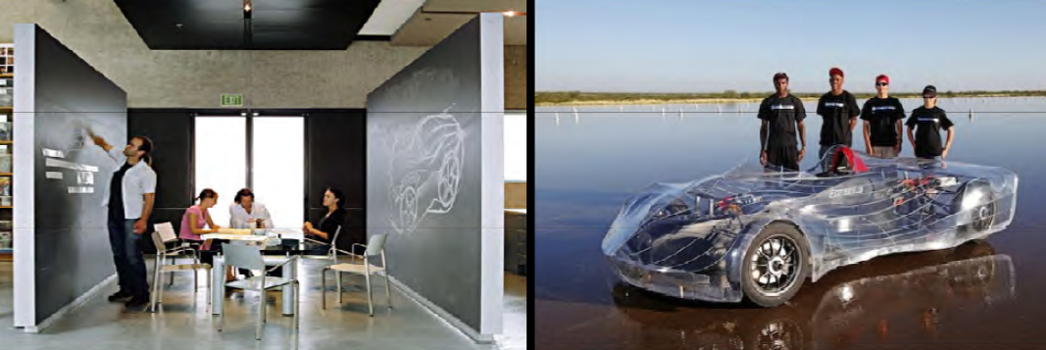
Story of how to use current experiential learning opportunities to develop future experiential learning opportunities

Slide 3
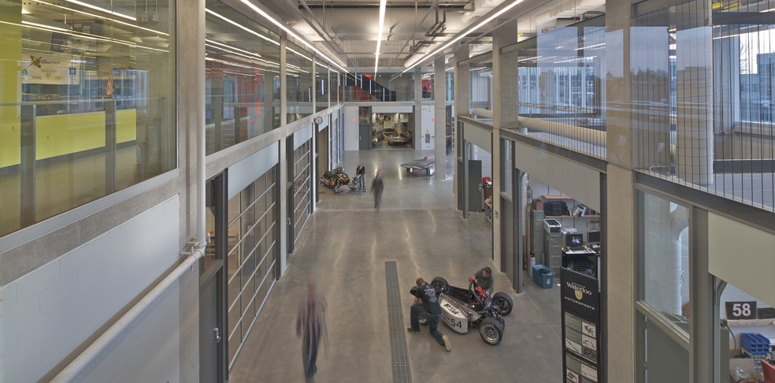
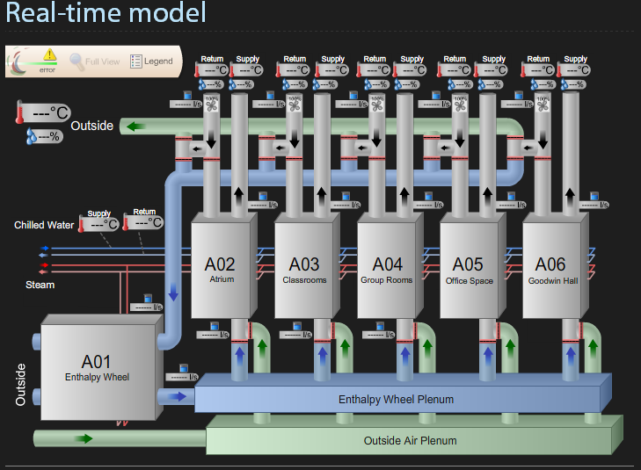
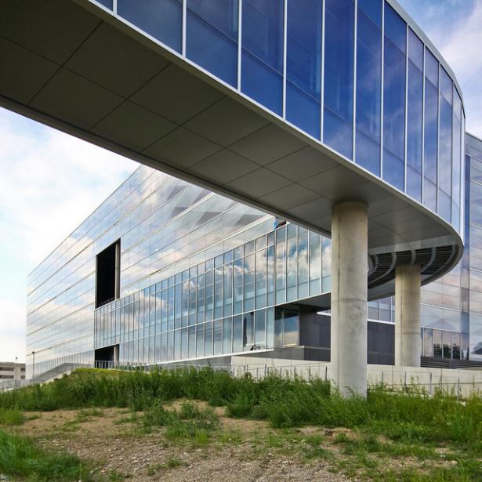
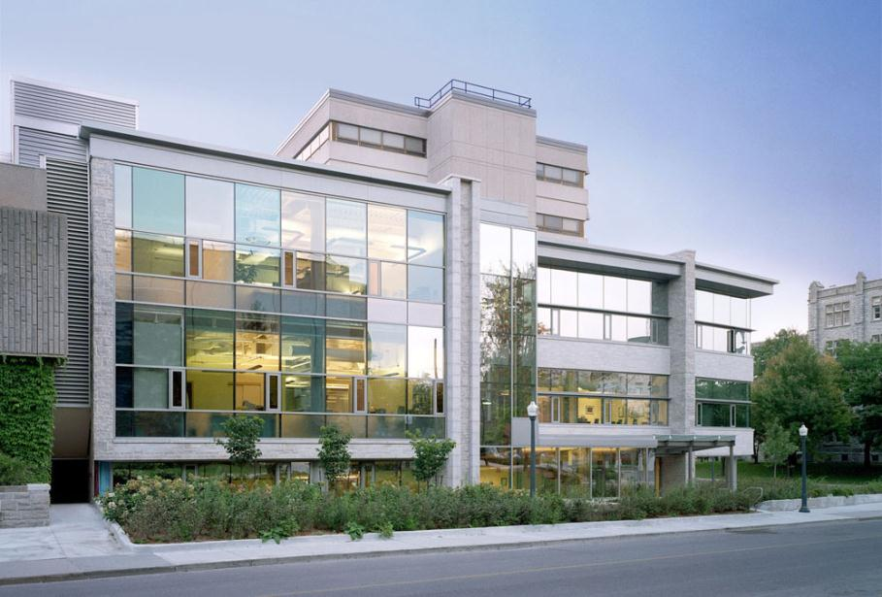
Background

Slide 4
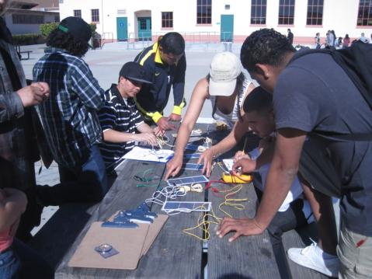
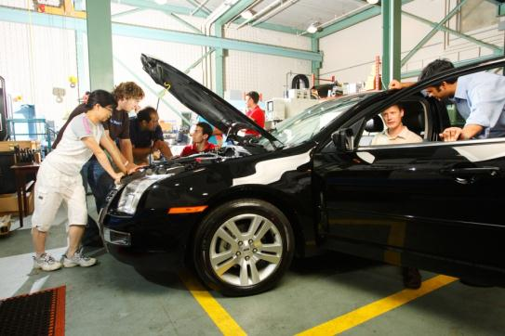
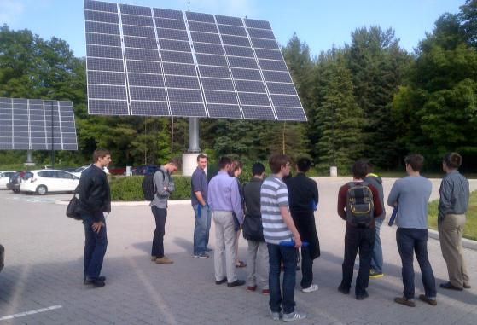
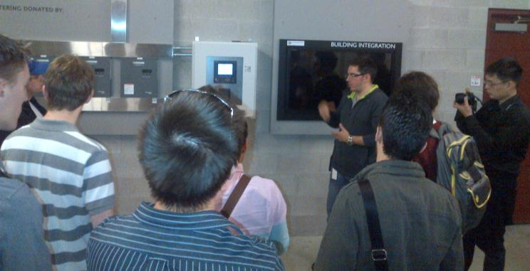
ExCEL’s Initial Goals
Experiential Learning
Living Lab of Sustainability

Slide 5
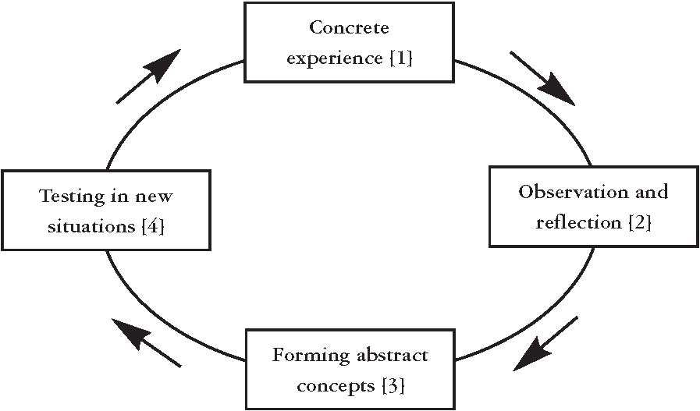
What is Experiential Learning?
The Experiential Learning Model is cyclical
Evidence based benefits:
– Complex processing
– Higher Order Thinking Skills
– Enjoy learning
– Cope with change
– And more!

Slide 6
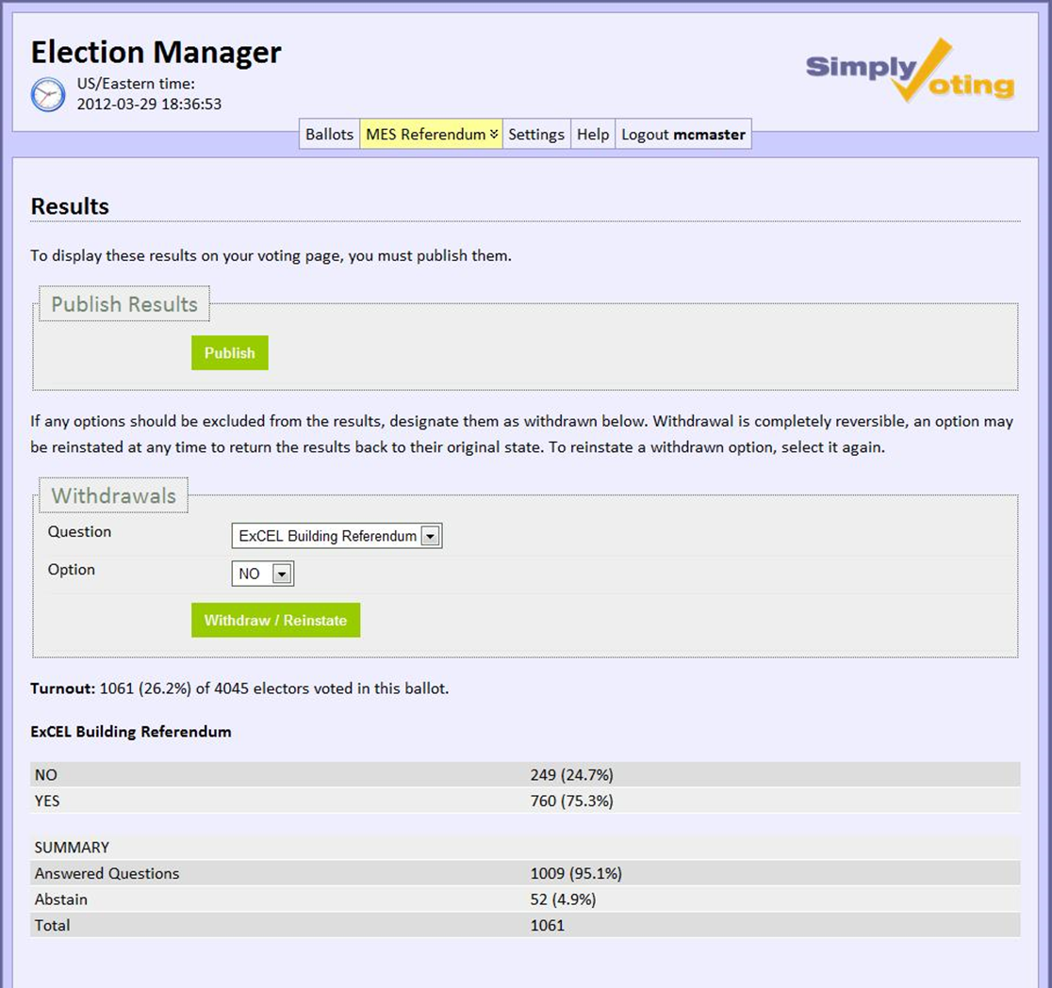
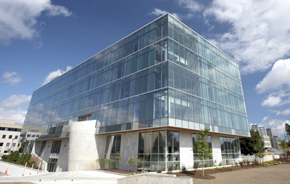

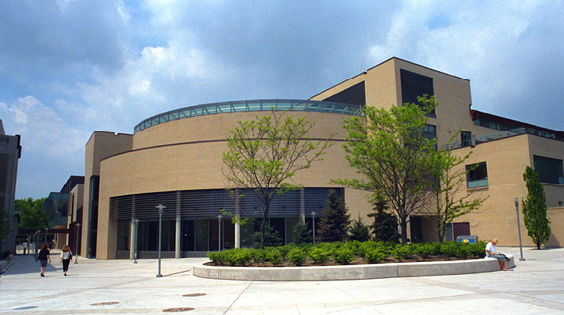
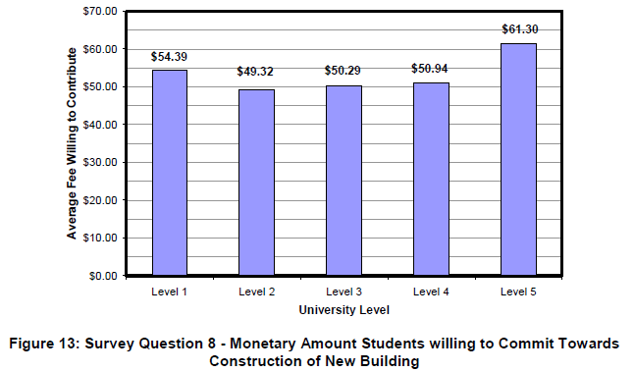
Funding
No Government funding available in time frame
No Government funding available in time frame
Donations Driven

Slide 7

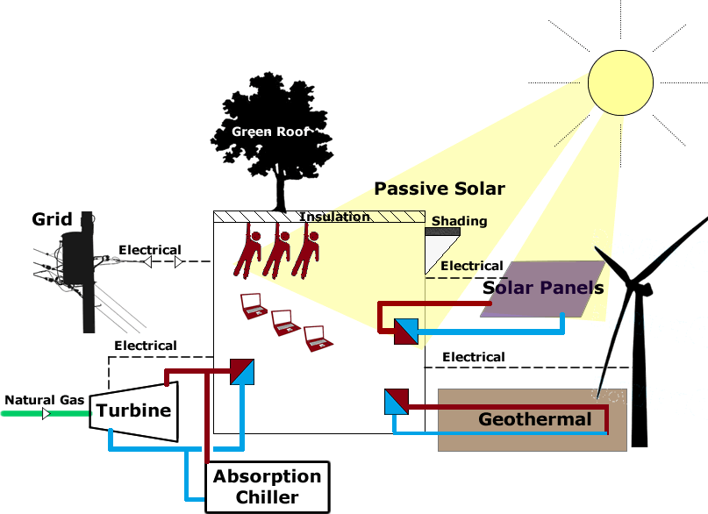
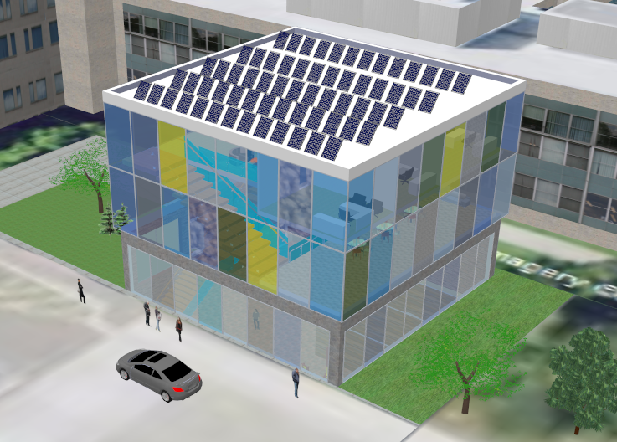
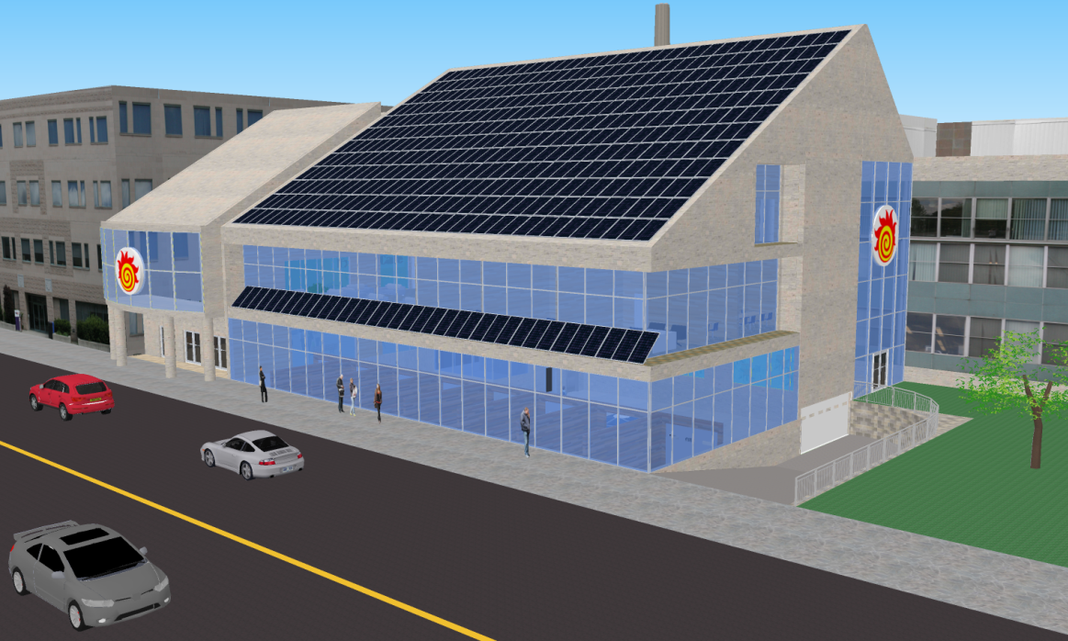
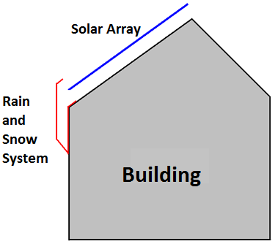
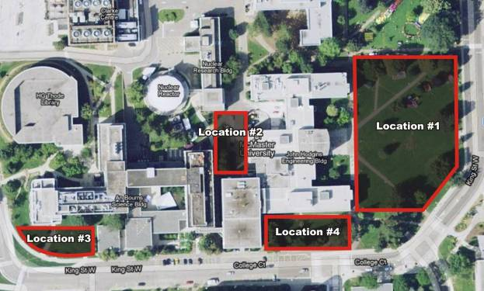
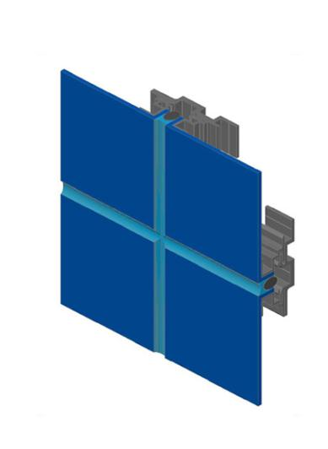
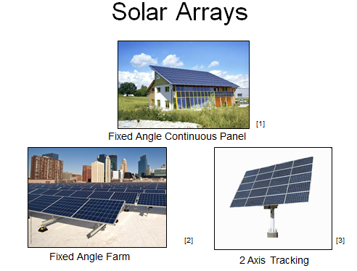
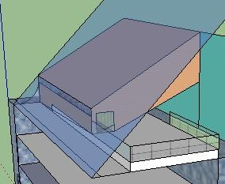
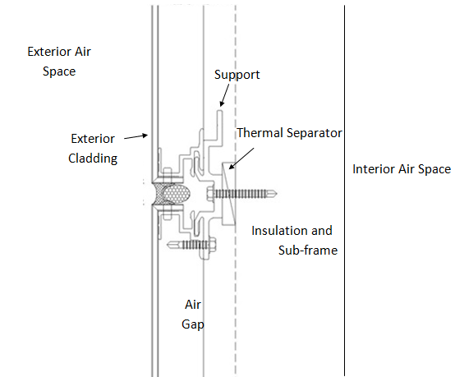
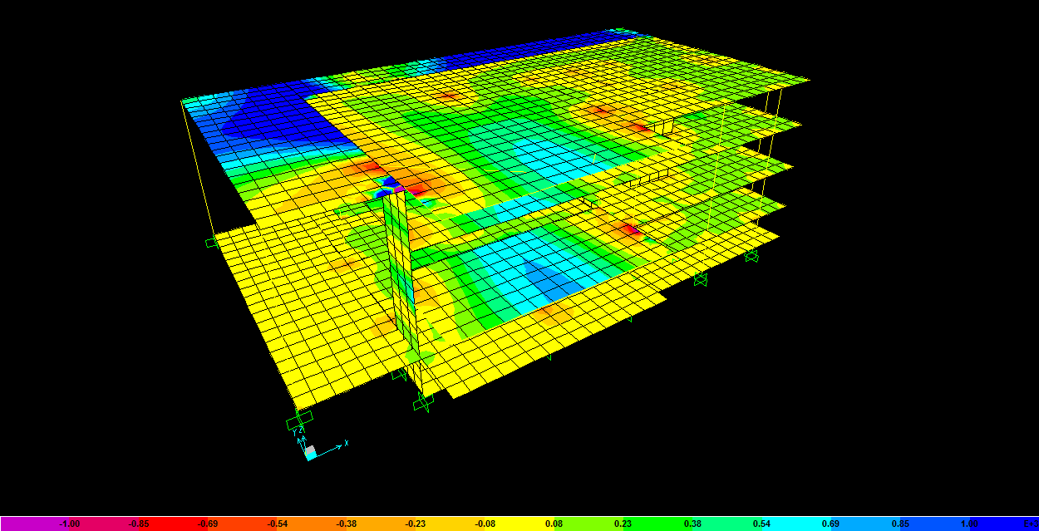
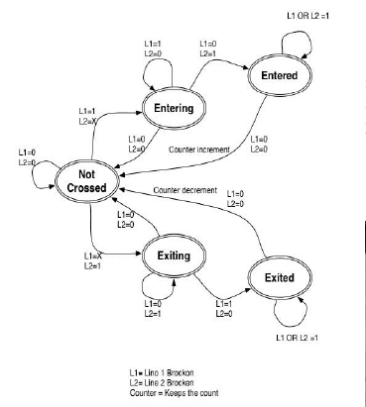
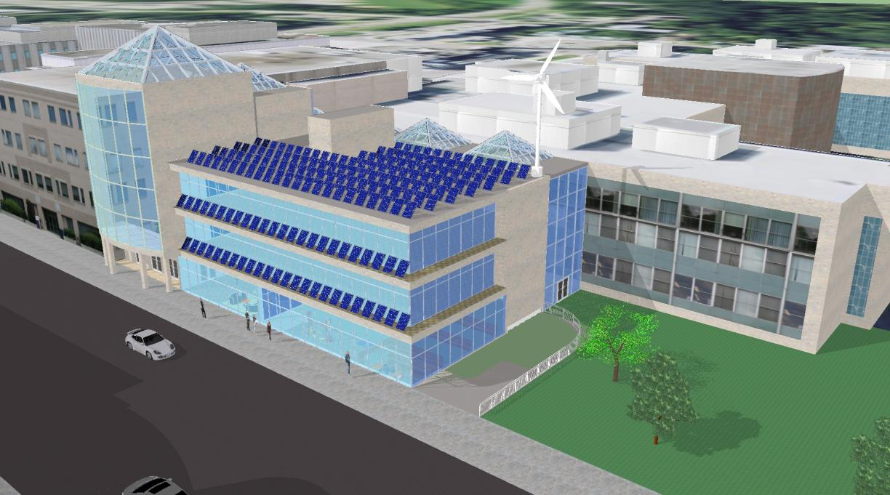
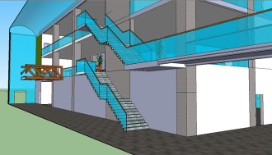
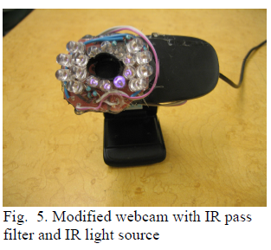
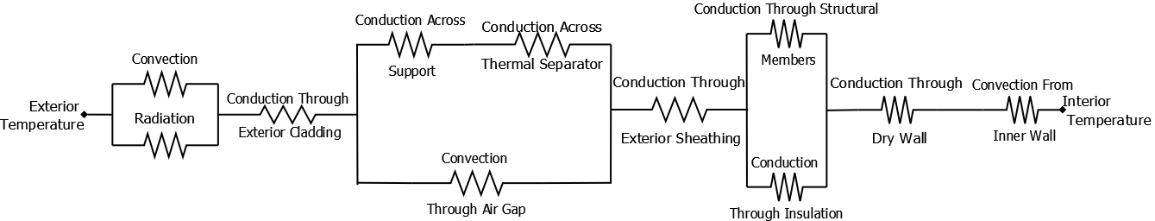
Design
Open ended design
Multi-disciplinary collaboration
Project-based learning
Professional development
Sustainability
Capstone Design Projects
  Teams acting as consultants, with Faculty as client
Industry-academic collaboration

Slide 8
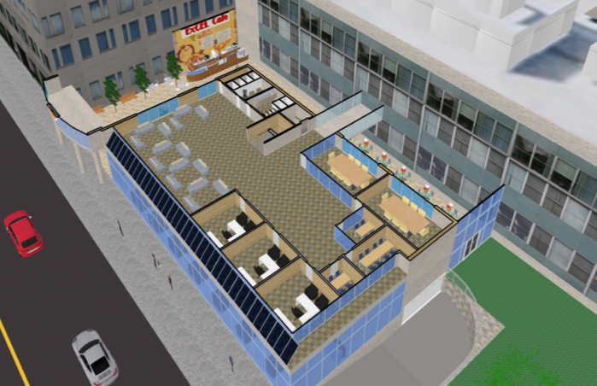
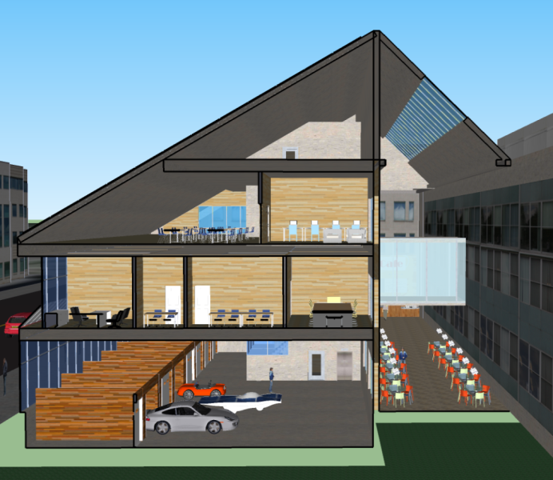
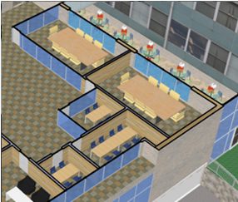
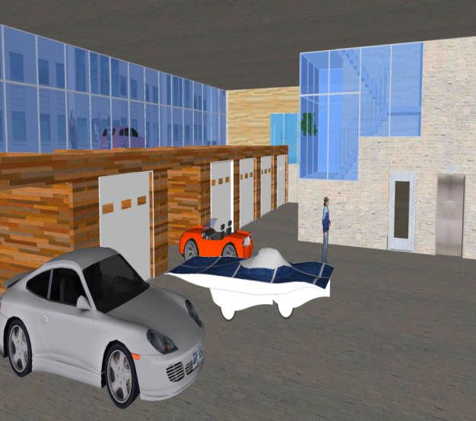
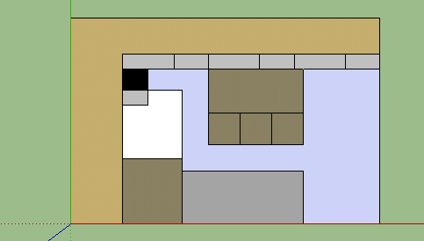
Design
ExCEL User Group Committee
Professional development

Slide 9
Student Projects - Total of 65 students
Mechanical Engineering 4M06
  Energy Systems Design and Analysis of the Engineering Student Centre (April 2011)
  Electrical and Thermal Energy Audit and Feasibility Study of a new net zero ExCEL Engineering Student Centre (April 2011)
  Solar Array Design for the Proposed ExCEL Building (April 2012)
Engineering Management 5B03
  Student Community Needs Assessment and Green Technology Research (December 2010)
  ExCEL Building Energy System Analysis and Recommendation (December 2011)
  Space Allocation Project for the ExCEL Building, McMaster University (December 2011)
  ExCEL Building Solutions: Occupancy Tracking and Security Access Systems (December 2012)
  Sobotec Cladding on ExCEL (December 2012)

Slide 10
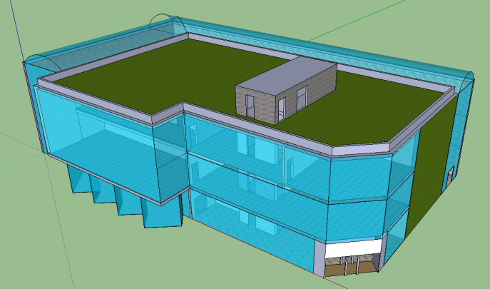
Student Projects - Total of 65 students
Civil Engineering 4R04
  The Engineering Student Centre (April 2011)
Materials 4I03
  Cellulose Vs. Fiberglass Insulation
  Concrete Vs. Steel Beam
  Silica Aerogel Vs. Double Pane Windows
  Linoleum Vs. Vinyl Flooring
Mechatronics 4TB6
  Using Biometrics for Secure Access (April 2013)
  Using Wireless Communications for Secure Access (April 2013)
Electrical and Computer Engineering 4OI6
  Secure Access Doors (April 2013)
Mechanical Engineering 3E05
  Flexibility of Rooms in ExCEL(April 2013)

Slide 11
ECE Capstone Ideas

Slide 12
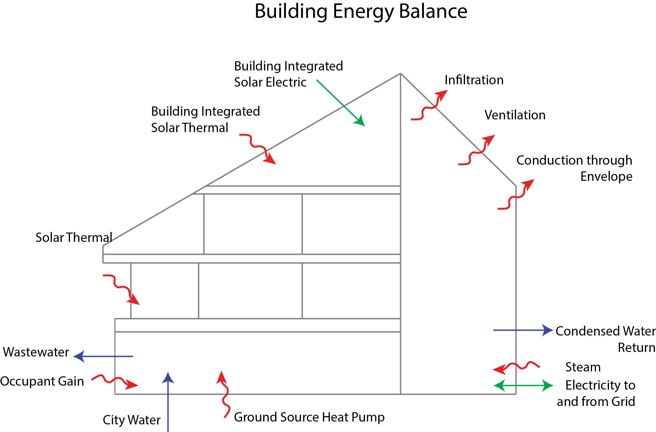
Energy Balance

Slide 13
Energy Balance

Slide 14
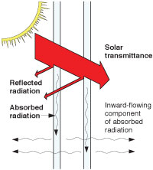
Solar Gain

Slide 15
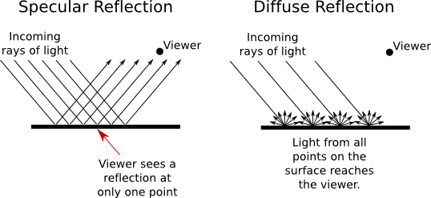
Diffuse v Direct Light

Slide 16
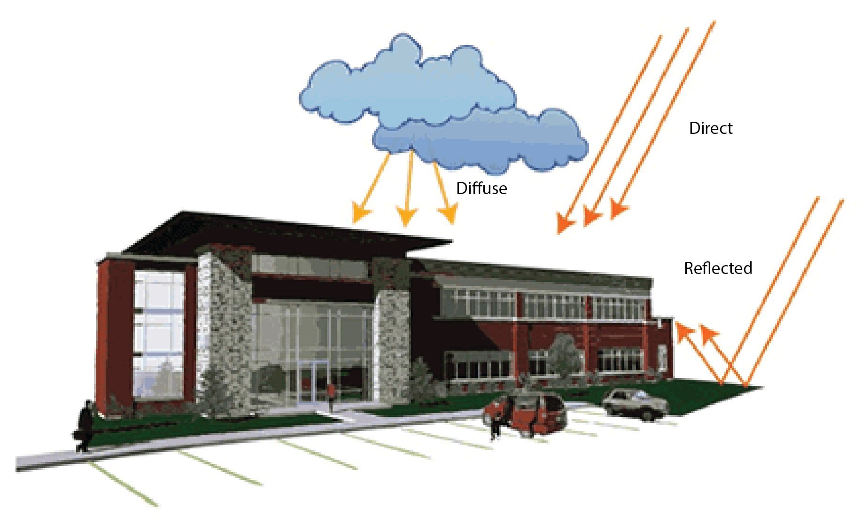
Example

Slide 17
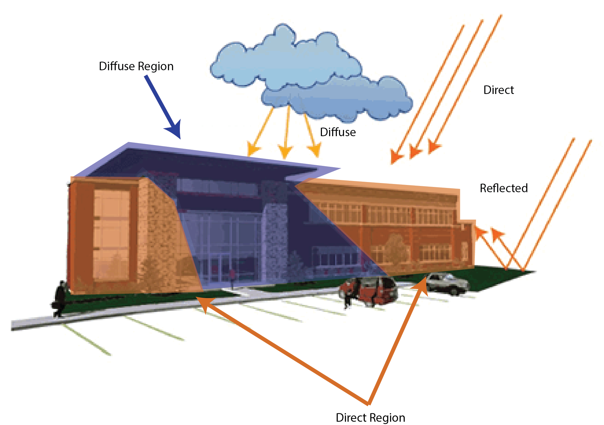
Determine Where Shade Is

Slide 18
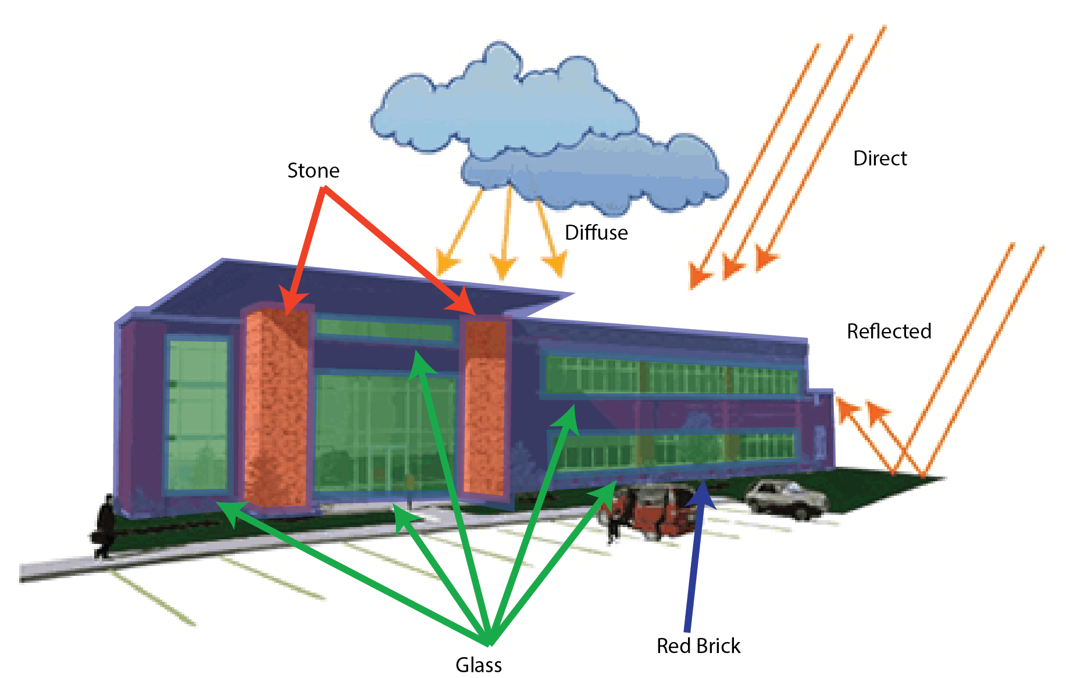
Account for Different Materials

Slide 19
Energy Balance

Slide 20
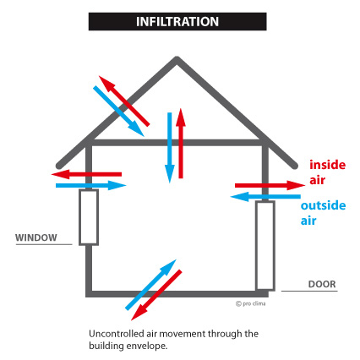
Infiltration Through Envelope

Slide 21
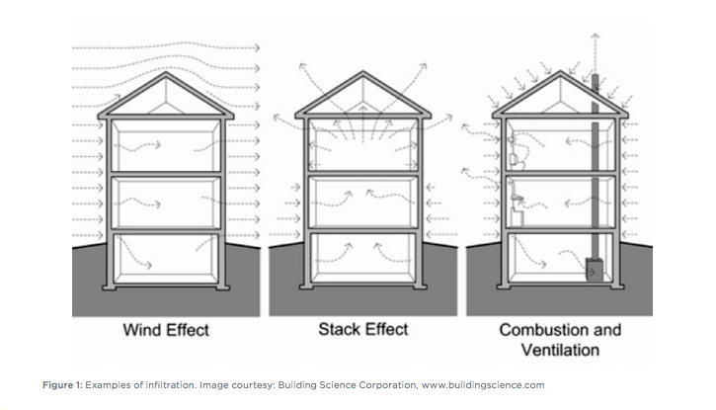
Drivers of Infiltration during Operation

Slide 22
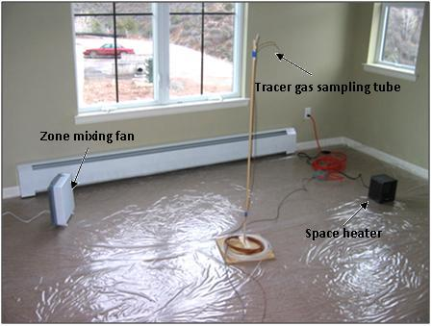
Tracer Gas Test

Slide 23
Common Tracer Gases
Carbon Dioxide
Nitrous Oxide
Helium
Sulfur Hexafluoride

Slide 24
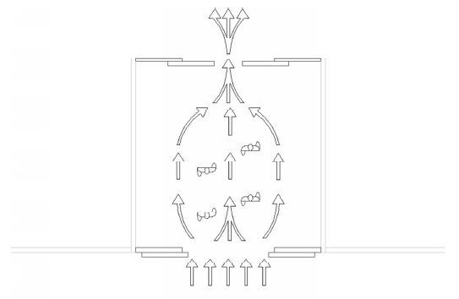
Infiltration Through Doors

Slide 25
When Door is Open
Q is air flow rate (cfm),
C_{A} is air flow coefficient (cfm/ft2-(in. of water)0.5), - Constants and Measureables
A is area of the door opening (ft2), and – Constant
R_{p} is a pressure factor (in. of water 0.5). - Measureable

Slide 26
Other Factors
When is the door open and for how long?
What is the energy lost during each door opening?

Slide 27

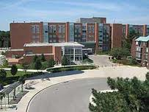
Security Services - Image Processing

Slide 28
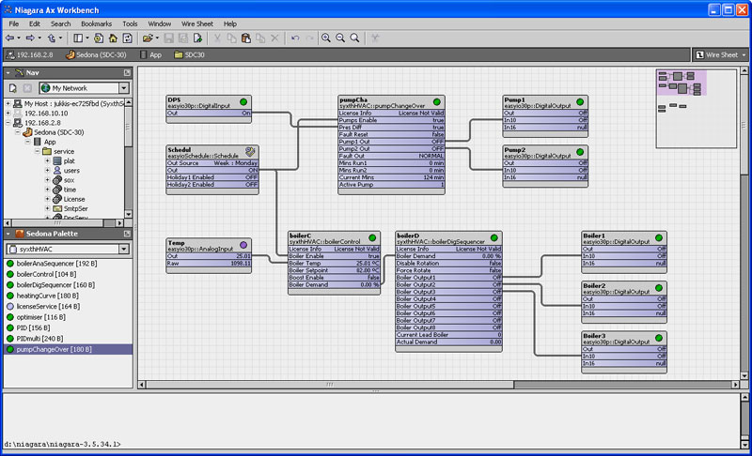
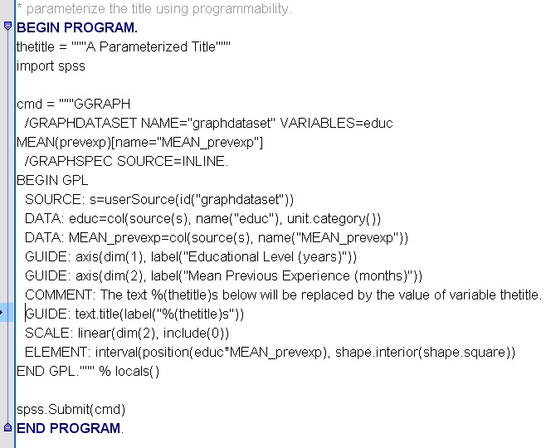
Facility Services – Block Programming

Slide 29
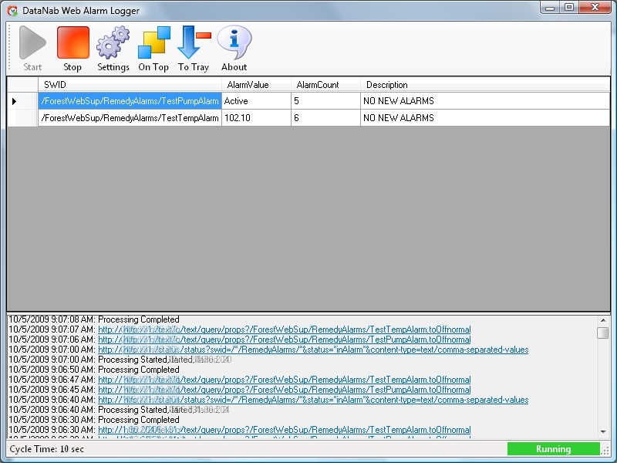

Facility Services – Building Alarm Notification

Slide 30



Augmented Reality in ExCEL

Slide 31


PV Panel Entire Performance Monitoring

Slide 32





PV Panel Retrofits to Increase Performance

Slide 33



Building Sensor Circuitry and Commissioning

Slide 34



Direct Current Microgrid Components for Maximizing Renewable Generation

Slide 35
Always open to other ideas!
For those that would like to engage on this Initiative Contact:
www.eng.mcmaster.ca/excel
Kelton Friedrich
JHE-123
905-525-9140 Ext 21524
friedrke@mcmaster.ca

Slide 36


Slide 37


Slide 38


Slide 39


Slide 40


Slide 41


